Slide 1

Bibitor LLC *
Inventory Analysis Case Study
Phase 2
*Note1: Bibitor, LLC is a fictitious company based on data created by the HUB of Analytics Education @ www.hubae.org.

Slide 2

Introduction and Case Overview
²

Slide 3
Objectives
This case study is designed to enhance your understanding and knowledge of data analytics, including leveraging analytics to make business decisions.
By completing this case, you will obtain the following:
An understanding of what data analytics and visualization are
The ability to utilize analytic tools
Comfort in leveraging data in making decisions
Skills to select data components for analysis and illustrate results to highlight data tracking and identify conditions for exception analysis or business advisory strategy

Slide 4
Case Format
You should plan to work in teams of 4 to 5 students to complete the case. This will give you the opportunity to share the learning, knowledge, and experience.
This case will be delivered in three phases. Each phase includes an instructional component to learn how to manage the data within the tool and case study exercises utilizing the skills.
Phase 1: Introduction to Data Preparation
Load data exported from company into SQLite to put it into a format for analysis and create tables which can be used by other analysis tools.
Phase 2: Introduction to Data Discovery and Visualization
Using tables created in Phase 1, load data into Tableau to perform analysis then create and interpret visualizations.
Phase 3: Introduction to Statistical Analysis
Analyze one set of independent/dependent variables from each of the two case studies and create a tableau worksheet that uses linear regression to provide some insight into the data.

Slide 5
Case Materials
All the materials required to complete the case can be found at ((LOCATION)).
Notes:
Instructor Note: Please update this slide with the location where you have uploaded the case materials to make them available to the students.

Slide 6
Case Background
Bibitor, LLC* is a liquor store chain in the fictional state of Lincoln. It is a major retailer with approximately 80 locations and total sales in excess of $450 million.
Bibitor has asked the team to complete due diligence on their wine and spirits business looking at data for their beginning and ending inventory, purchases and sales for a 12 month period.
*Bibitor, LLC is a fictitious company based on data created by the HUB of Analytics Education @ www.hubae.org. The HUB of Analytics Education materials are owned by Northeastern University. PricewaterhouseCoopers LLP is not responsible for any errors or omissions in, or for the results obtained from the use of, the HUB of Analytics Education. The HUB of Analytics Education materials are provided "as is", with no guarantee of completeness, accuracy, timeliness or of the results obtained from the use of this information, and without warranty of any kind. In no event will PricewaterhouseCoopers LLP, or its partners, principals, employees, or agents, be liable to you or anyone else for any decision made or action taken in reliance on the information in the HUB of Analytics Education materials or for any consequential, special or similar damages, even if advised of the possibility of such damages.

Slide 7
Getting Started – Phase 2 Pre-work
Download/Install Tableau and Tableau Reader
Review background information on Tableau and other Data Discovery applications. Follow guidance in 3. below
In the Tableau application, open Help, then ... 1. Get Started - understanding Dimensions & Measures 2. Analyze 3. Present 4. Watch training videos
Use Google as a resource and search for Tableau Cheat Sheets for handy guidance

Slide 8
Phase 2 – Introduction to Data Discovery and Visualization
⁸

Slide 9
Data Discovery and Visualization
Now that the data is compiled into usable tables, the steps in this phase will show you how to load these tables into a tool to create and interpret visualizations.

Slide 10
Review of Pre-Work and Case Results
Notes:
Instructor Note: Use this time to review the students’ pre-work to ensure that they are ready to proceed with Phase 2.

Slide 11
Data Pre-Processing
Using the database from Phase 1, create a table with the following:
For each unique record-- ‘Brand’ (e.g. Product SKU) by ‘Store’-- in table EndInvDec, recalculate the ‘PurchasePrice’ assuming the costing method is moving-average cost.
Assume that each transaction per table SalesDec reduces inventory on-hand quantities and that each transaction in table increases inventory on-hand quantities.
Your resulting table should include [A] a new column with the re-calculated purchase price using moving-average cost based on actual transactions; the resulting table should also include [B] a new field that calculates the difference between the ‘PurchasePrice’ per table EndInvDec and the recalculated column (column [A]).
Assume that quantities & prices in table BegInvDec are as-of 12/1/2016.
Hint: Sales & Purchases transaction tables include data from prior to December.
Review Appendix3_Section2_1_SQLPrepTable.txt
Notes:
Instructor Note: Refer to Appendix3_Section2_1_SQLPrepTable.txt with SQLite scripts used to generate prep table

Slide 12
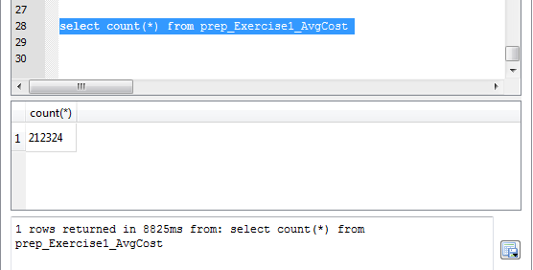
Data Pre-Processing
Notes:
Instructor Note: Refer to Appendix3_Section2_1_SQLPrepTable.txt with SQLite scripts used to generate prep table.
Note that even if the students do not result with the same row count, if they have a large number of rows say >100,000) they will likely have enough information to successfully visualize and analyze selected data.

Slide 13
Link Visualization File to Source Data
Export prep table from Exercise 1a above to excel, and save to local folder.
Note: DO NOT USE SQL DB Export feature; simply copy/paste table from query results into an excel file, and include your column names in the top header row.
Open Tableau application. Click Connect → to Text file → navigate to prep table saved locally in previous step.
Notes:
Instructor Note: Please refer to Appendix4_prep_Exercise1_AvgCost.xls for source prep table or Appendix5_Sect2_Visual Example.twb to facilitate this section.

Slide 14
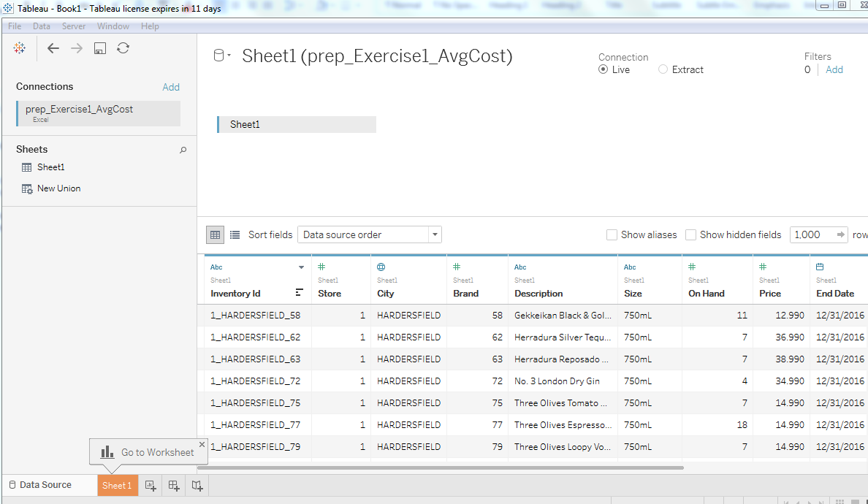
Link Visualization File to Source Data
Notes:
Instructor Note: Please refer to Appendix4_prep_Exercise1_AvgCost.xls for source prep table or Appendix5_Sect2_Visual Example.twb to facilitate this section.

Slide 15
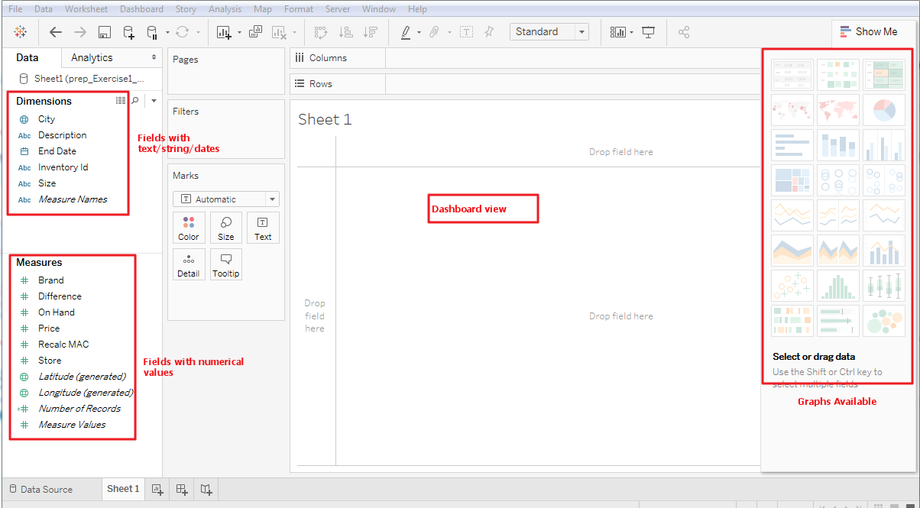
General Navigation

Slide 16
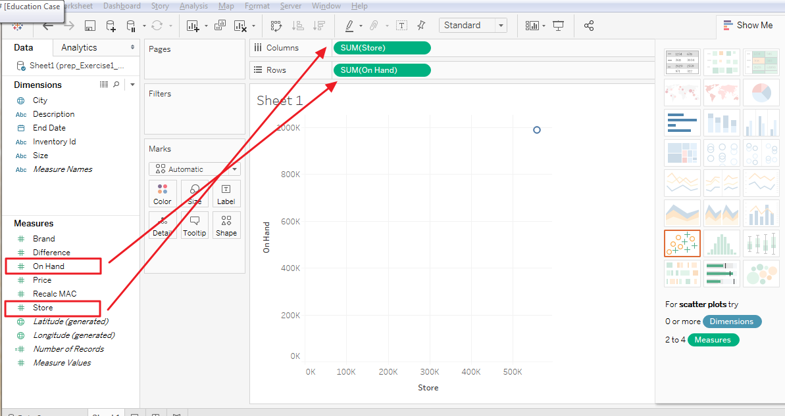
Become Familiar with Basic Functions
Drag the ‘Store’ field to the Columns breadcrumb, and drag the ‘OnHand’ field to the Rows breadcrumb.

Slide 17
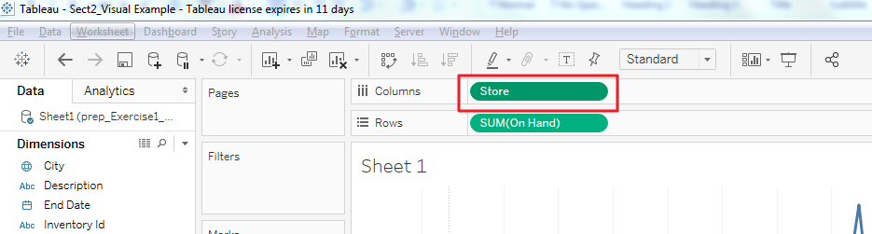
Become Familiar with Basic Functions
Tableau treated the imported source data in field ‘Store’ as an integer, rather than a string.
We will not be calculating values within the ‘Store’ field. As such, click the drop down on ‘Store’ within the Columns breadcrumb, and select ‘Dimension’.

Slide 18
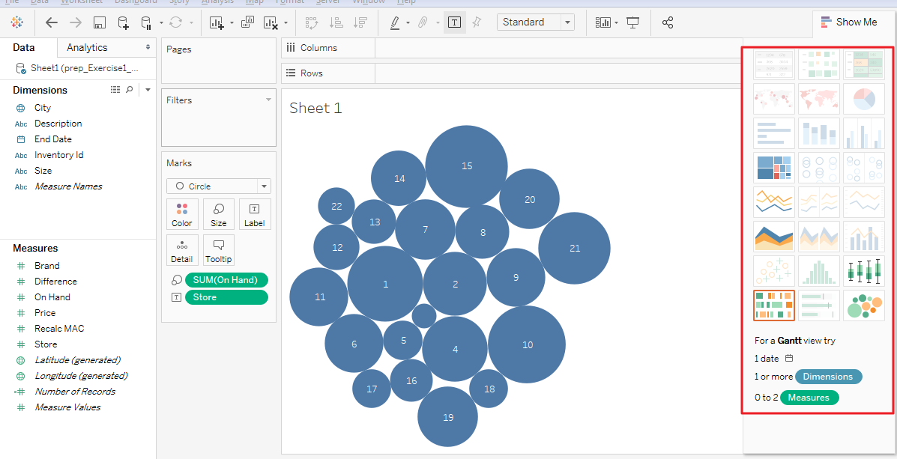
Become Familiar with Basic Functions
Try selecting each graph type to see which type may fit the data set best.
For now, let’s use the ‘Packed Bubbles’ graph type.
How should we interpret this?

Slide 19
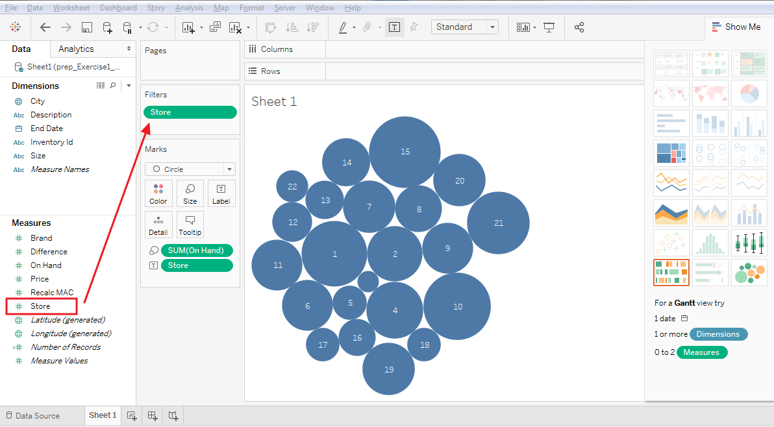
Become Familiar with Basic Functions
Using Filters: Drag the ‘Store’ field to the ‘Filter’ card.

Slide 20
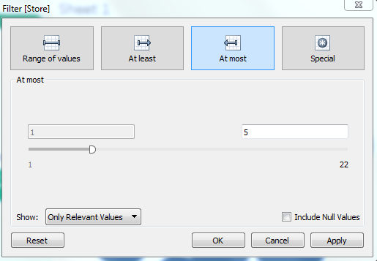
Become Familiar with Basic Functions
Drill into the filter details and select only the range of stores from 1 to 5

Slide 21
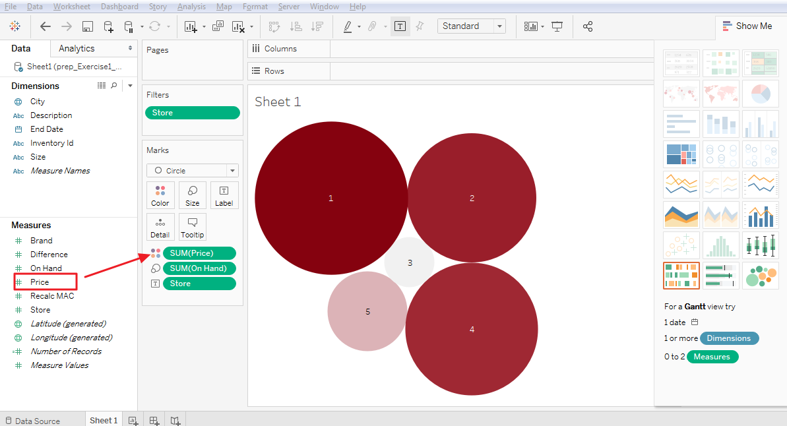
Become Familiar with Basic Functions
Using Marks: marks are features uses to identify specific datapoints.
In this example, marks are represented by the size, color, and number of circles.
Drag the “Price” field to the ‘Color’ mark—the field should default to a calculated value (sum(Price)).
You can change the color by clicking on the generic ‘Color’ box inside the Marks card.
Next, drag field ‘Difference’ to the ‘Size’ mark.
How would you interpret this graph?

Slide 22
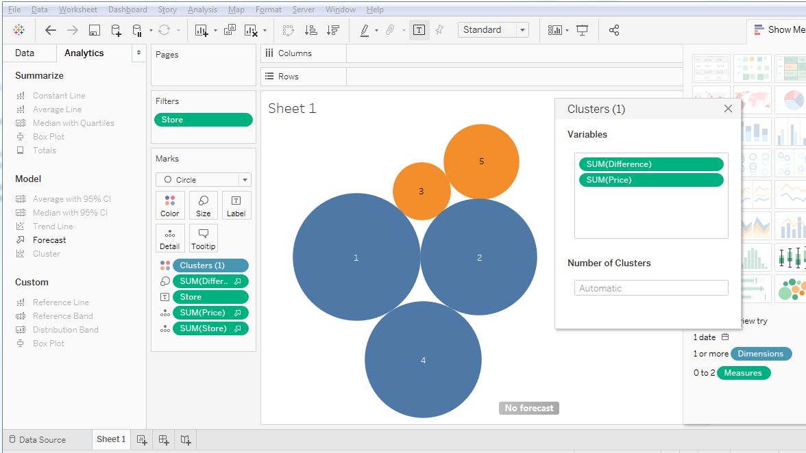
Become Familiar with Basic Functions
Using Analytics: some standard methods of analysis are built into Tableau.
Click and drag a ‘Cluster’ model into the sheet.
Drill into the cluster variables and ensure the variables are ordered by sum(Difference) , then by sum(Price).
Values for respective individual clusters will be re-colored to a consistent color and arranged together, based upon similar values for the defined variable characteristics.

Slide 23
Become Familiar with Basic Functions
Increase the number of clusters (automatically defaulted to 2) to 3 as an example of how to manipulate the clustering.

Slide 24
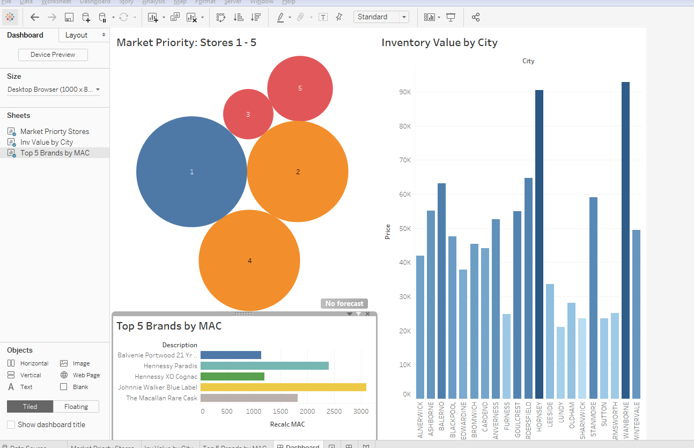
Become Familiar with Basic Functions
Dashboards vs. Worksheets – a dashboard can contain multiple worksheets.

Slide 25
Case Studies
²⁶

Slide 26
Instructions
Create a basic dashboard using the SQL prep tables created in Phase 1

Slide 27
Case 1
Executive leadership is looking for dashboard reporting that would be useful to help identify and monitor vendor activity in order to focus efforts strategically on key supplier relationships.
Create (1) an aggregate table that includes all critical vendor billings and their associated purchasing activity
Create (2) separate tables to store key information, such as ‘top 10 vendors’ by quantity purchased. Name all tables you create ‘c1_Prep_[table_name]’
Notes:
Instructors: Consider if you want your students to submit documentation of completion of the assignment (e.g., export into excel and email excel file, copy screen shots and email, etc) and modify steps as appropriate.

Slide 28
Case 2
You notice that there is inventory that is purchased but sits on the shelf for a long period of time rather than being sold.
As such, there is an opportunity to add value to the procurement process by identifying trends in the timing inventory purchased versus its corresponding sale.
Consider key data points around purchase prices, seasonality, and vendor information in creating an aggregate table for future visual & statistical analysis.
Name the table you create ‘c2_Prep_[table_name]’.
Notes:
Instructors: Consider if you want your students to submit documentation of completion of the assignment (e.g., export into excel and email excel file, copy screen shots and email, etc) and modify steps as appropriate.

Slide 29
Next Steps
³⁰

Slide 30
Phase 3 Pre-work
Review background information on Linear Regression (you do not need to download “R” when you read the article):
https://www.hackerearth.com/practice/machine-learning/machine-learning-algorithms/beginners-guide-regression-analysis-plot-interpretations/tutorial/
Review Basic Concepts
Single-variable Linear Regression (Definition): a statistical method that allows for the evaluation of the relationship between two continuous variables, one predictor (input) variable –‘x’, and one response (output) variable—‘y’.

Slide 31
Phase 3 Pre-work
The key function is the same as the standard form of an algebraic linear equation:
f(x) = b + a(x) = y
Where x is the independent (predictor) variable, y, or f(x), is the dependent (response) variable, b is a constant, and a is the slope of the line.
Purpose: we are applying this function in order to predict the outcome of a future event/input. The function approximates the line of ‘best fit’ given the relationship of two variables based upon pre-existing/historical data. As such, in reference to the following example graph, we would expect that new events with input value = 4, would result in an output value of ~12.5.

Slide 32
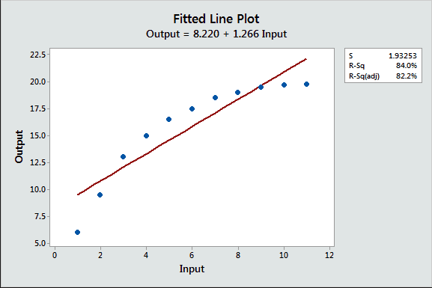
Phase 3 Pre-work
Source: https://www.google.com/search?q=basic+linear+equation+graph&rlz=1C1GGRV_enUS753US753&source=lnms&tbm=isch&sa=X&ved=0ahUKEwjf29uDvJPVAhUKfiYKHQBvANIQ_AUICigB&biw=1533&bih=761#tbm=isch&q=basic+fitting+line+graph&imgrc=PG9RR9w1ofQR6M

Slide 33

Phase 3 Pre-work
Deriving the Slope of the line of best fit:
Numerator: for each known data point, calculate the sum of the variances – where point is each known event, and is the calculated mean of the independent variable values, and the is the calculated mean of the dependent variable values.
Denominator: for each known independent variable value, calculate the sum of squares of variance –where is each known independent variable value and is the calculated mean.

Slide 34

Phase 3 Pre-work
Deriving the Constant of the line of best fit:
Where a is slope, is the calculated mean of the dependent variable values, and is the calculated mean of the independent variable values.

Slide 35
Thank You.

